Slide 1

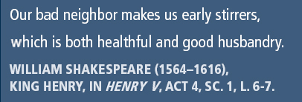
Principles of Information Security,
Fifth Edition
Chapter 2
The Need for Security

Slide 2
Learning Objectives
  Discuss the organizational business need for information security
  Explain why a successful information security program is the shared responsibility of an organization’s general management and IT management
  List and describe the threats posed to information security and common attacks associated with those threats
  Describe the relationship between threats and attacks against information within systems
Principles of Information Security, Fifth Edition
Notes:
These learning objectives frame information security as a business-critical capability, not a purely technical function. At Level 8, you should recognise that information security directly supports organisational resilience, regulatory compliance, and strategic continuity. The objectives also establish that responsibility for security is distributed across management and IT, reinforcing governance and accountability rather than technical ownership alone.

Slide 3
Introduction
The primary mission of an information security program is to ensure information assets—information and the systems that house them—remain safe and useful.
If no threats existed, resources could be used exclusively to improve systems that contain, use, and transmit information.
Threat of attacks on information systems is a constant concern.
Principles of Information Security, Fifth Edition
Notes:
The core mission of information security is to ensure that information assets remain confidential, accurate, and available while continuing to deliver organisational value. At an advanced level, it is important to recognise that security does not exist to eliminate risk entirely, but to manage risk to an acceptable level aligned with organisational objectives. The constant presence of threats means security investment is a trade-off between protection, usability, and cost.

Slide 4
Business Needs First
Information security performs four important functions for an organization:
  Protecting the organization’s ability to function
  Protecting the data and information the organization collects and uses
  Enabling the safe operation of applications running on the organization’s IT systems
  Safeguarding the organization’s technology assets
Principles of Information Security, Fifth Edition
Notes:
Information security must be driven by business priorities, not technology trends. Protecting organisational functionality ensures continuity of operations, while safeguarding data underpins trust with customers, partners, and regulators. We need to understand that security enables innovation by providing a controlled environment in which systems and applications can operate safely, rather than acting as a constraint on business growth.

Slide 5
Protecting the Functionality of an Organization
Management (general and IT) is responsible for facilitating security program.
Implementing information security has more to do with management than technology.
Communities of interest should address information security in terms of business impact and cost of business interruption.
Principles of Information Security, Fifth Edition
Notes:
Security implementation is fundamentally a management responsibility, requiring leadership, policy direction, and resource allocation. While IT executes controls, senior management must evaluate security decisions in terms of business impact, reputational damage, and financial loss. Communities of interest, including executives, users, and IT professionals, must collaboratively assess the cost of disruption versus the cost of prevention.

Slide 6
Protecting Data That Organizations Collect and Use
Without data, an organization loses its record of transactions and ability to deliver value to customers.
Protecting data in transmission, in processing, and at rest (storage) is a critical aspect of information security.
Principles of Information Security, Fifth Edition
Notes:
Data is a core organisational asset, and its loss compromises operational effectiveness, legal compliance, and strategic decision-making. Protecting data across its lifecycle—during transmission, processing, and storage—requires layered controls and governance oversight. We need to critically consider how failures in data protection often result from process weaknesses and human behaviour, not just technical flaws.

Slide 7
Enabling the Safe Operation of Applications
Organization needs environments that safeguard applications using IT systems.
Management must continue to oversee infrastructure once in place—not relegate to IT department.
Principles of Information Security, Fifth Edition
Notes:
Modern organisations rely on tightly integrated applications that amplify both productivity and risk. Management oversight must extend beyond system deployment into ongoing governance, ensuring that security configurations, access rights, and updates align with organisational risk appetite. Delegating security entirely to IT creates governance gaps that expose applications to misuse and exploitation.

Slide 8
Safeguarding Technology Assets in Organizations
Organizations must employ secure infrastructure hardware appropriate to the size and scope of the enterprise.
Additional security services may be needed as the organization grows.
More robust solutions should replace security programs the organization has outgrown.
Principles of Information Security, Fifth Edition
Notes:
Infrastructure security must scale with organisational growth and complexity. As systems evolve, legacy security controls may become ineffective or introduce new vulnerabilities. At an advanced level, the need for continuous assessment and replacement of outdated controls, supported by long-term strategic planning rather than reactive upgrades.

Slide 9
Threats
Threat: a potential risk to an asset’s loss of value
Management must be informed about the various threats to an organization’s people, applications, data, and information systems.
Overall security is improving, so is the number of potential hackers.
The 2010–2011 CSI/FBI survey found
  67.1 percent of organizations had malware infections.
  11 percent indicated system penetration by an outsider.
Principles of Information Security, Fifth Edition
Notes:
A threat represents any circumstance that can reduce the value of an information asset. While technical defences improve over time, the threat landscape expands simultaneously, driven by increased connectivity and automation. Management awareness of threats is critical, as strategic decisions influence exposure levels far more than individual technical controls.

Slide 10
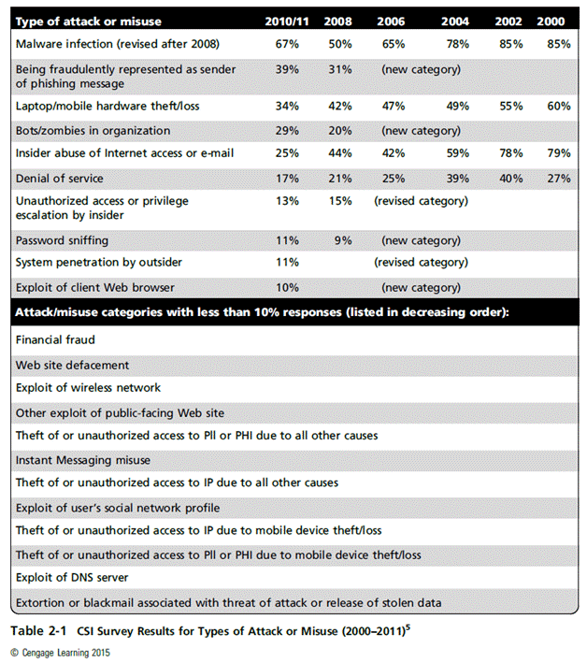
PII: Personally Identifiable Information
PHI: Protected Health Information
Principles of Information Security, Fifth Edition
Notes:
PII and PHI represent high-value targets due to their legal, financial, and ethical implications. We need to understand that breaches involving sensitive data often lead to regulatory penalties, reputational damage, and long-term trust erosion, making their protection a governance priority rather than a technical afterthought.

Slide 11
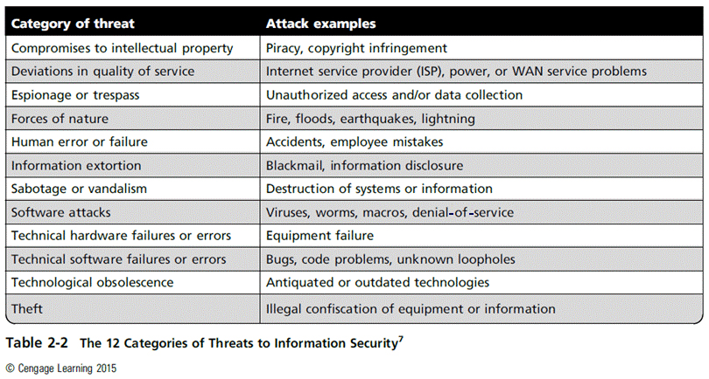
Principles of Information Security, Fifth Edition
Notes:
Intellectual property underpins competitive advantage and organisational sustainability. Breaches—particularly software piracy—erode both financial value and innovation capacity. Advanced analysis requires recognising that legal enforcement alone is insufficient; technical, procedural, and cultural controls must work together to protect IP effectively.

Slide 12
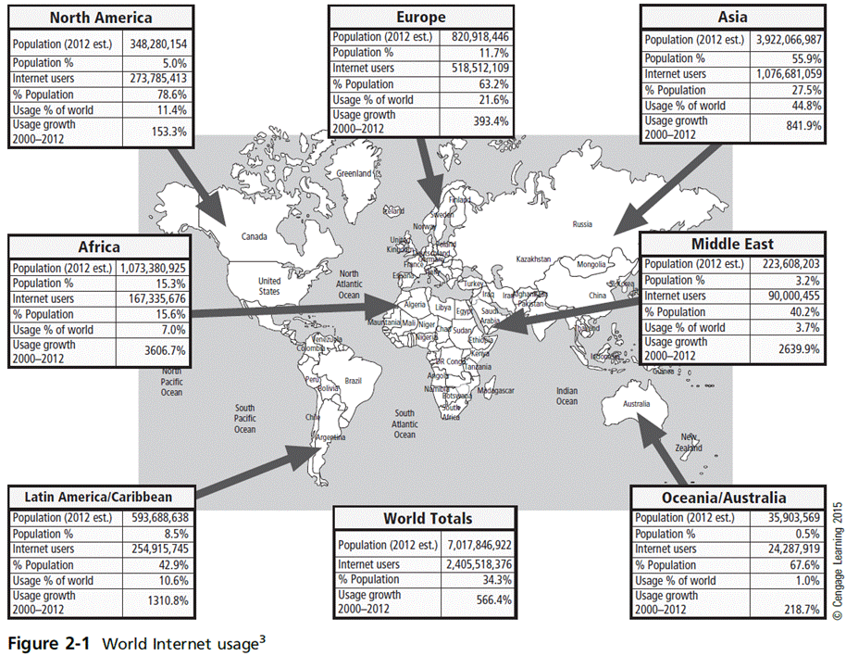
Principles of Information Security, Fifth Edition

Slide 13
Class Activity
Reading of 2015 US State of Cybercrime Survey
Principles of Information Security, Fifth Edition

Slide 14
Class Activity
Reading of 2015 US State of Cybercrime Survey
Discuss Key findings
What business are concern of?
Principles of Information Security, Fifth Edition
Notes:
Compromises to Intellectual Property
Many organizations create or support the development of intellectual property as part of their business operations.
Intellectual property is defined as “the ownership of ideas and control over the tangible or virtual representation of those ideas.”
Intellectual property for an organization includes trade secrets, copyrights, trademarks, and patents.
Once intellectual property (IP) has been defined and properly identified, breaches to IP constitute a threat to the security of this information.
Most common IP breaches involve the unlawful use or duplication of software-based intellectual property, known as software piracy.
In addition to the laws surrounding software piracy, two watchdog organizations investigate allegations of software abuse: Software & Information Industry Association (SIIA), formerly the Software Publishers Association, and the Business Software Alliance (BSA).
Enforcement of copyright violations, piracy, and the like has been attempted through a number of technical security mechanisms, including digital watermarks, embedded codes.

Slide 15
Compromises to Intellectual Property
Intellectual property (IP): creation, ownership, and control of original ideas as well as the representation of those ideas
The most common IP breaches involve software piracy.
Two watchdog organizations investigate software abuse:
  Software & Information Industry Association (SIIA)
  Business Software Alliance (BSA)‏
Enforcement of copyright law has been attempted with technical security mechanisms.
Principles of Information Security, Fifth Edition
Notes:
Many organizations create or support the development of intellectual property as part of their business operations.
Intellectual property is defined as “the ownership of ideas and control over the tangible or virtual representation of those ideas.”
Intellectual property for an organization includes trade secrets, copyrights, trademarks, and patents.
Once intellectual property (IP) has been defined and properly identified, breaches to IP constitute a threat to the security of this information.
Most common IP breaches involve the unlawful use or duplication of software-based intellectual property, known as software piracy.
In addition to the laws surrounding software piracy, two watchdog organizations investigate allegations of software abuse: Software & Information Industry Association (SIIA), formerly the Software Publishers Association, and the Business Software Alliance (BSA).
Enforcement of copyright violations, piracy, and the like has been attempted through a number of technical security mechanisms, including digital watermarks, embedded codes.

Slide 16
Deviations in Quality of Service
Information system depends on the successful operation of many interdependent support systems.
Internet service, communications, and power irregularities dramatically affect the availability of information and systems.
Principles of Information Security, Fifth Edition
Notes:
Information systems depend on complex interdependencies beyond organisational control. Failures in internet connectivity, utilities, or third-party services directly affect availability. We should evaluate outsourcing risks critically and understand the importance of service-level agreements, redundancy, and contingency planning.

Slide 17
Deviations in Quality of Service (cont’d)
Internet service issues
  Internet service provider (ISP) failures can considerably undermine the availability of information.
  Outsourced Web hosting provider assumes responsibility for all Internet services as well as for the hardware and Web site operating system software.
Communications and other service provider issues
  Other utility services affect organizations: telephone, water, wastewater, trash pickup.
  Loss of these services can affect organization’s ability to function.
Principles of Information Security, Fifth Edition
Notes:
Internet Service Issues
For organizations that rely heavily on the Internet and the Web to support continued operations, the threat of the potential loss of Internet service can lead to considerable loss in the availability of information.
Many organizations have sales staff and telecommuters working at remote locations.
When an organization places its Web servers in the care of a Web hosting provider, that outsourcer assumes responsibility for all Internet services as well as for the hardware and operating system software used to operate the Web site.
Communications and Other Service Provider Issues
Other utility services can impact organizations as well.
Among these are telephone, water, wastewater, trash pickup, cable television, natural or propane gas, and custodial services.
The threat of loss of these services can lead to the inability of an organization to function properly.

Slide 18
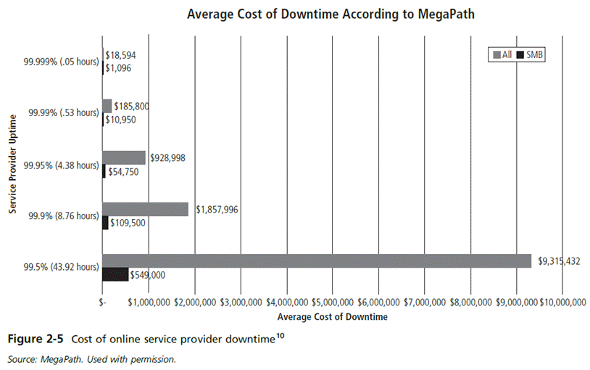
Principles of Information Security, Fifth Edition

Slide 19
Deviations in Quality of Service (cont’d)
Power irregularities
  Commonplace
  Lead to fluctuations such as power excesses, power shortages, and power losses
  Sensitive electronic equipment vulnerable to and easily damaged/destroyed by fluctuations
  Controls can be applied to manage power quality.
Principles of Information Security, Fifth Edition
Notes:
Power instability presents a persistent operational risk, particularly for sensitive digital infrastructure. While often overlooked, power fluctuations can cause data corruption and hardware failure. Effective controls—such as UPS systems and surge protection—illustrate how low-visibility risks can have high organisational impact if unmanaged.

Slide 20
Espionage or Trespass
Access of protected information by unauthorized individuals
Competitive intelligence (legal) versus industrial
espionage (illegal)‏
Shoulder surfing can occur anywhere a person accesses confidential information.
Controls let trespassers know they are encroaching on organization’s cyberspace.
Hackers use skill, guile, or fraud to bypass controls protecting others’ information.
Principles of Information Security, Fifth Edition
Notes:
Unauthorised access threatens confidentiality and competitive positioning. The distinction between competitive intelligence and industrial espionage highlights legal and ethical boundaries. At an advanced level, students should understand that human factors—such as shoulder surfing and social manipulation—remain among the most effective attack vectors.

Slide 21
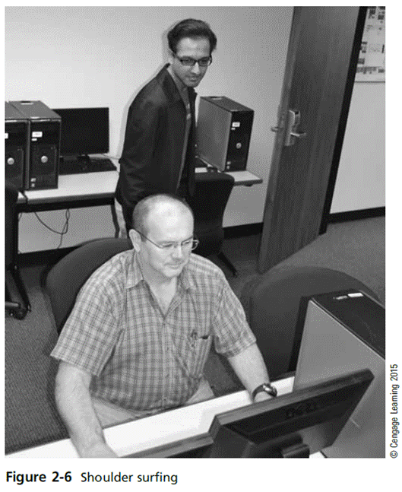
Principles of Information Security, Fifth Edition

Slide 22
Espionage or Trespass (cont’d)‏
Expert hacker
  Develops software scripts and program exploits
  Usually a master of many skills
  Will often create attack software and share with others
Unskilled hacker
  Many more unskilled hackers than expert hackers
  Use expertly written software to exploit a system
  Do not usually fully understand the systems they hack
Principles of Information Security, Fifth Edition
Notes:
The threat landscape includes both highly skilled attackers and low-skill individuals using automated tools. While expert hackers develop exploits, most attacks exploit known vulnerabilities and poor organisational hygiene. This reinforces the importance of patch management, monitoring, and policy enforcement.

Slide 23
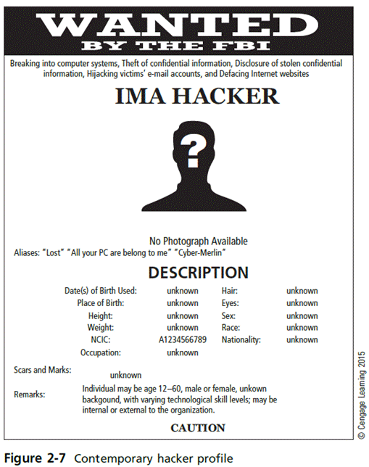
Principles of Information Security, Fifth Edition

Slide 24
Espionage or Trespass (cont’d)‏
Other terms for system rule breakers:
  Cracker: “cracks” or removes software protection designed to prevent unauthorized duplication
  Phreaker: hacks the public telephone system to make free calls or disrupt services
Password attacks
  Cracking
  Brute force
  Dictionary
  Rainbow tables
  Social engineering
Principles of Information Security, Fifth Edition
Notes:
Password attacks and social engineering exploit predictable human behaviour rather than system weaknesses. We should recognise that awareness training and behavioural controls are as critical as encryption and authentication technologies.

Slide 25
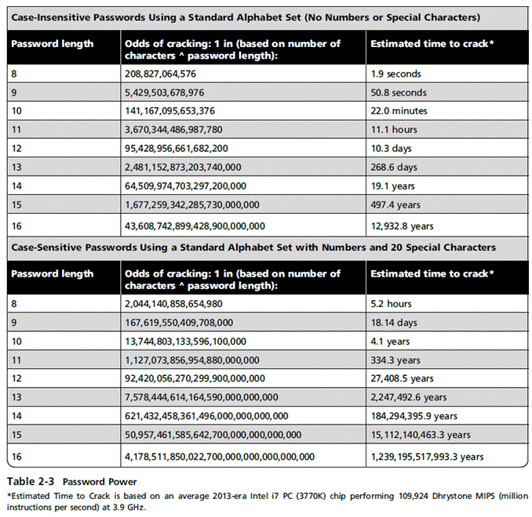
Principles of Information Security, Fifth Edition

Slide 26
Forces of Nature
Forces of nature can present some of the most dangerous threats.
They disrupt not only individual lives, but also storage, transmission, and use of information.
Organizations must implement controls to limit damage and prepare contingency plans for continued operations.
Principles of Information Security, Fifth Edition
Notes:
Natural disasters pose unavoidable risks that can severely disrupt information systems. Since prevention is often impossible, organisations must prioritise resilience, disaster recovery, and business continuity planning to ensure survival rather than mere protection.

Slide 27
Human Error or Failure
Includes acts performed without malicious intent or in ignorance
Causes include:
  Inexperience
  Improper training
  Incorrect assumptions
Employees are among the greatest threats to an organization’s data.
Principles of Information Security, Fifth Edition
Notes:
Employees represent both the greatest asset and the greatest risk to information security. Errors arising from poor training or assumptions can have consequences equivalent to deliberate attacks. Advanced security strategy therefore emphasises education, accountability, and process design to reduce reliance on perfect human behaviour.

Slide 28
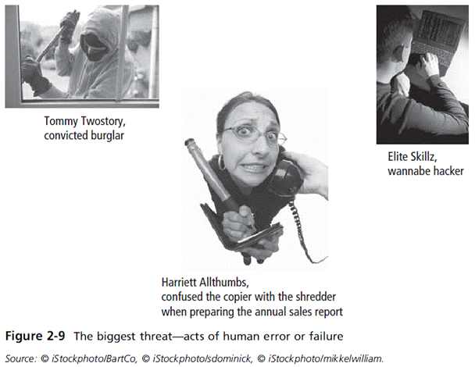
Principles of Information Security, Fifth Edition
Notes:
Elite Skillz, wannabe hacker, is my favorite part of this entire chapter. I am laughing entirely too hard.

Slide 29
Human Error or Failure (cont’d)‏
Employee mistakes can easily lead to:
  Revelation of classified data
  Entry of erroneous data
  Accidental data deletion or modification
  Data storage in unprotected areas
  Failure to protect information
Many of these threats can be prevented with training, ongoing awareness activities, and controls.
Social engineering uses social skills to convince people to reveal access credentials or other valuable information to an attacker.
Principles of Information Security, Fifth Edition
Notes:
Human Error or Failure
Employee mistakes can easily lead to:
Revelation of classified data
Entry of erroneous data
Accidental data deletion or modification
Data storage in unprotected areas
Failure to protect information
Many of these threats can be prevented with controls

Slide 30
Social Engineering‏
“People are the weakest link. You can have the best technology; firewalls, intrusion-detection systems, biometric devices ... and somebody can call an unsuspecting employee. That's all she wrote, baby. They got everything.”—Kevin Mitnick
Advance-fee fraud: indicates recipient is due money and small advance fee/personal banking information required to facilitate transfer
Phishing: attempt to gain personal/confidential information; apparent legitimate communication hides embedded code that redirects user to third-party site
Principles of Information Security, Fifth Edition
Notes:
Social engineering attacks demonstrate that technology alone cannot secure information assets. We should critically assess how organisational culture, trust relationships, and time pressure contribute to successful attacks—and how leadership can mitigate these risks.

Slide 31
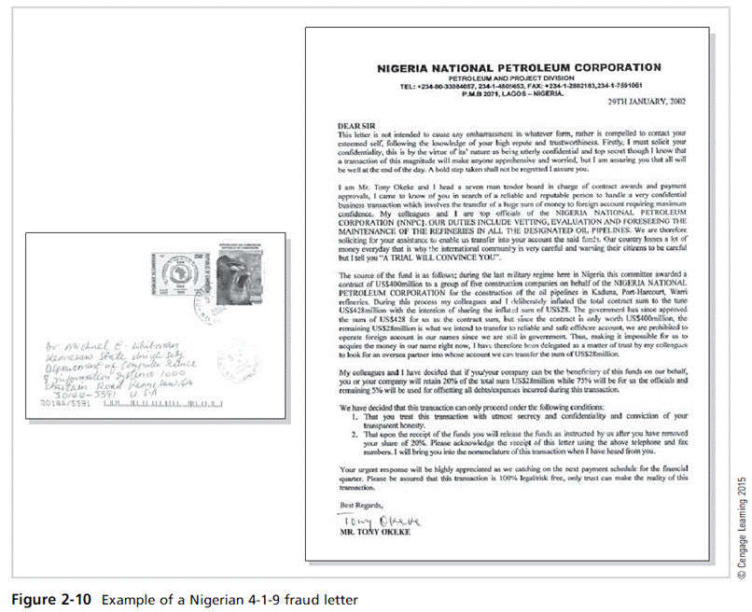
Principles of Information Security, Fifth Edition

Slide 32
Information Extortion
Attacker steals information from a computer system and demands compensation for its return or nondisclosure. Also known as cyberextortion.
Commonly done in credit card number theft
Principles of Information Security, Fifth Edition
Notes:
Information extortion highlights the monetisation of stolen data and the strategic leverage attackers gain through disclosure threats. This reinforces the need for incident response planning, detection capabilities, and legal readiness.

Slide 33
Sabotage or Vandalism
Threats can range from petty vandalism to organized sabotage.
Web site defacing can erode consumer confidence, diminishing organization’s sales, net worth, and reputation.
Threat of hacktivist or cyberactivist operations is rising.
Cyberterrorism/Cyberwarfare: a much more sinister form of hacking
Principles of Information Security, Fifth Edition
Notes:
From website defacement to cyberterrorism, sabotage attacks undermine trust and organisational legitimacy. Advanced analysis requires understanding the political, ideological, and reputational motivations behind such attacks—not just the technical methods.

Slide 34
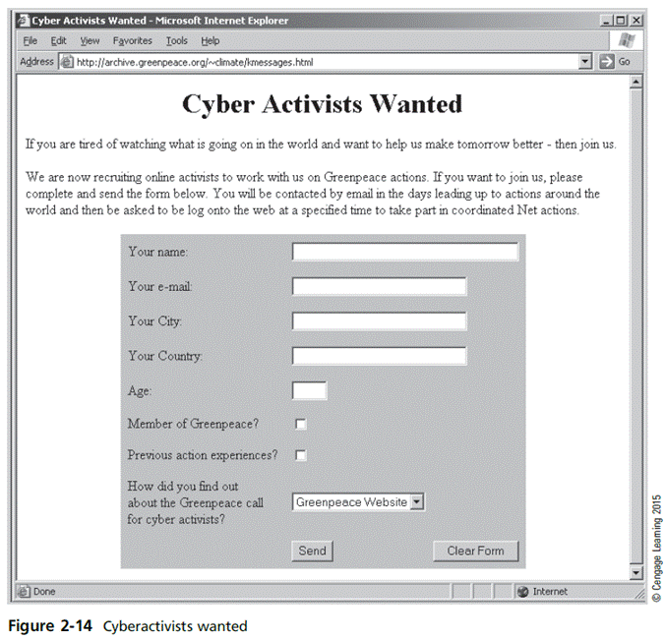
Principles of Information Security, Fifth Edition

Slide 35
Software Attacks
Malicious software (malware) is used to overwhelm the processing capabilities of online systems or to gain access to protected systems via hidden means.
Software attacks occur when an individual or a group designs and deploys software to attack a system.
Principles of Information Security, Fifth Edition
Notes:
Malware exploits vulnerabilities at scale, often using automation to overwhelm defences. At Level 8, students should evaluate how poor software design, delayed patching, and weak governance enable these attacks more than technical sophistication alone.

Slide 36
Software Attacks (cont’d)
Types of attacks include:
  Malware (malicious code): It includes the execution of viruses, worms, Trojan horses, and active Web scripts with the intent to destroy or steal information.
    Virus: It consists of code segments that attach to existing program and take control of access to the targeted computer.
    Worms: They replicate themselves until they completely fill available resources such as memory and hard drive space.
    Trojan horses: malware disguised as helpful, interesting, or necessary pieces of software
Principles of Information Security, Fifth Edition
Notes:
Attacks
An attack is the deliberate act that exploits vulnerability.
It is accomplished by a threat agent to damage or steal an organization’s information or physical asset.
An exploit is a technique to compromise a system. Vulnerability is an identified weakness of a controlled system whose controls are not present or are no longer effective. An attack is then the use of an exploit to achieve the compromise of a controlled system.
Malicious Code
This kind of attack includes the execution of viruses, worms, Trojan horses, and active Web scripts with the intent to destroy or steal information.
The state of the art in attacking systems in 2002 is the multivector worm.
These attack programs use up to six known attack vectors to exploit a variety of vulnerabilities in commonly found information system devices.

Slide 37
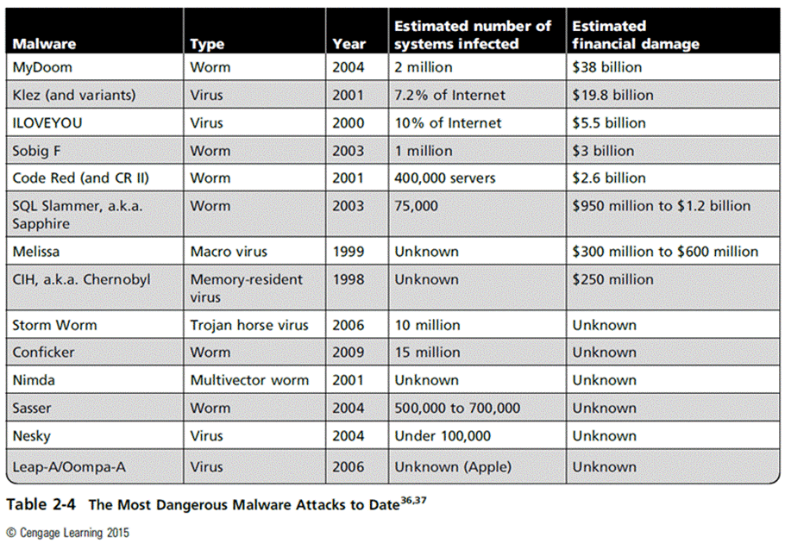
New Table
Principles of Information Security, Fifth Edition

Slide 38
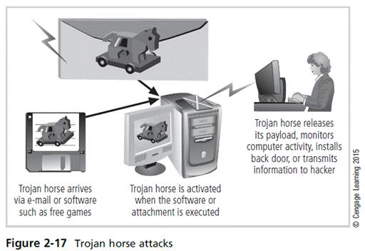
Principles of Information Security, Fifth Edition

Slide 39
Software Attacks (cont’d)‏
Types of attacks (cont’d)
    Polymorphic threat: actually evolves to evade detection
    Virus and worm hoaxes: nonexistent malware that employees waste time spreading awareness about
  Back door: gaining access to system or network using known or previously unknown/newly discovered access mechanism
Principles of Information Security, Fifth Edition
Notes:
Attack Descriptions
Back Doors - Using a known or previously unknown and newly discovered access mechanism, an attacker can gain access to a system or network resource.
Password Crack - Attempting to reverse calculate a password.
Brute Force - The application of computing and network resources to try every possible combination of options of a password.
Dictionary - The dictionary password attack narrows the field by selecting specific accounts to attack and uses a list of commonly used passwords (the dictionary) to guess with.

Slide 40
Software Attacks (cont’d)‏
Types of attacks (cont’d)
  Denial-of-service (DoS): An attacker sends a large number of connection or information requests to a target.
    The target system becomes overloaded and cannot respond to legitimate requests for service.
    It may result in system crash or inability to perform ordinary functions.
  Distributed denial-of-service (DDoS): A coordinated stream of requests is launched against a target from many locations simultaneously.
Principles of Information Security, Fifth Edition
Notes:
Attack Descriptions (continued)
Denial-of-Service (DoS) - The attacker sends a large number of connection or information requests to a target. So many requests are made that the target system cannot handle them successfully along with other, legitimate requests for service. This may result in a system crash or merely an inability to perform ordinary functions.
Distributed Denial-of-Service (DDoS) - An attack in which a coordinated stream of requests is launched against a target from many locations at the same time.

Slide 41
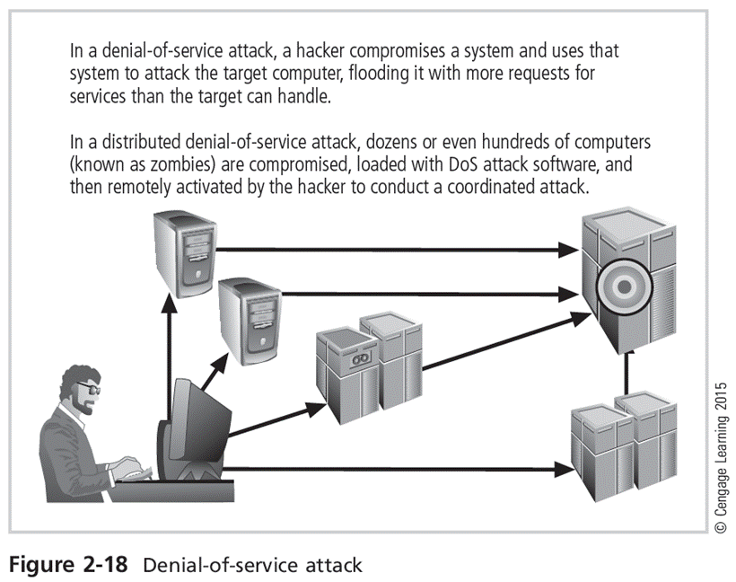
Principles of Information Security, Fifth Edition

Slide 42
Software Attacks (cont’d)‏
Types of attacks (cont’d)
  Mail bombing (also a DoS): An attacker routes large quantities of e-mail to target to overwhelm the receiver.
  Spam (unsolicited commercial e-mail): It is considered more a nuisance than an attack, though is emerging as a vector for some attacks.
  Packet sniffer: It monitors data traveling over network; it can be used both for legitimate management purposes and for stealing information from a network.
  Spoofing: A technique used to gain unauthorized access; intruder assumes a trusted IP address.
Principles of Information Security, Fifth Edition
Notes:
Attack Descriptions (continued)
Spoofing - A technique used to gain unauthorized access to computers, whereby the intruder sends messages to a computer with an IP address indicating that the message is coming from a trusted host.
Man-in-the-Middle - In the man-in-the-middle or TCP hijacking attack, an attacker sniffs packets from the network, modifies them, and inserts them back into the network.
Spam - Unsolicited commercial e-mail. While many consider spam a nuisance rather than an attack, it is emerging as a vector for some attacks.
Mail Bombing - Another form of e-mail attack that is also a DoS, in which an attacker routes large quantities of e-mail to the target.

Slide 43
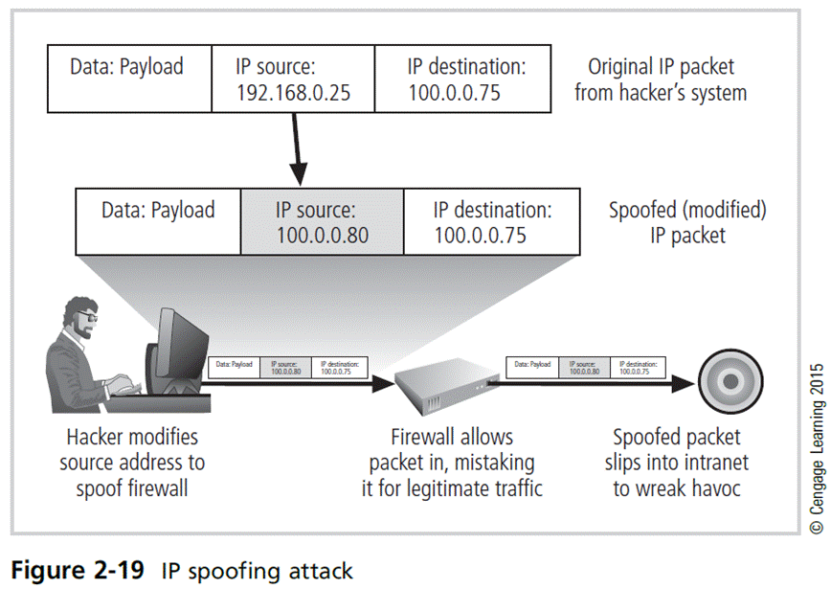
Principles of Information Security, Fifth Edition

Slide 44
Software Attacks (cont’d)‏
Types of attacks (cont’d)
  Pharming: It attacks a browser’s address bar to redirect users to an illegitimate site for the purpose of obtaining private information.
  Man-in-the-middle: An attacker monitors the network packets, modifies them, and inserts them back into the network.
Principles of Information Security, Fifth Edition
Notes:
An attack is the realisation of a vulnerability through an exploit. Effective security management therefore focuses on reducing vulnerabilities and attack surfaces, rather than responding only after incidents occur.

Slide 45
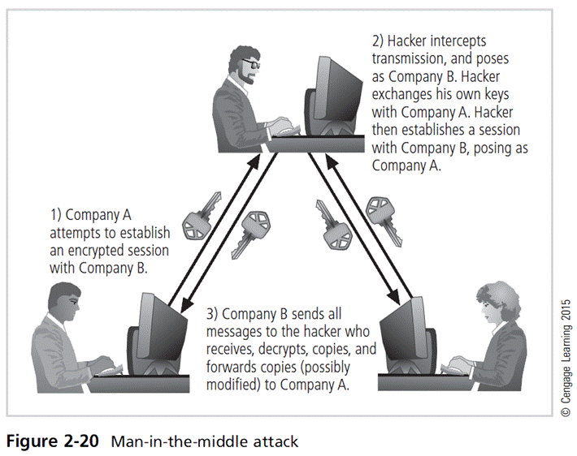
Principles of Information Security, Fifth Edition

Slide 46
Technical Hardware Failures or Errors
They occur when a manufacturer distributes equipment containing a known or unknown flaw.
They can cause the system to perform outside of expected parameters, resulting in unreliable service or lack of availability.
Some errors are terminal and some are intermittent.
Intel Pentium CPU failure
Mean time between failure measures the amount of time between hardware failures.
Principles of Information Security, Fifth Edition
Notes:
Failures resulting from design flaws or bugs highlight the limits of testing and quality assurance. Advanced security practice requires acknowledging that failure is inevitable, and systems must be designed to fail safely and recover quickly.

Slide 47
Technical Software Failures or Errors (cont’d)
Large quantities of computer code are written, debugged, published, and sold before all bugs are detected and resolved.
Combinations of certain software and hardware can reveal new software bugs.
Entire Web sites are dedicated to documenting bugs.
Open Web Application Security Project (OWASP) is dedicated to helping organizations create/operate trustworthy software and publishes a list of top security risks.
Principles of Information Security, Fifth Edition
Notes:
Technical Software Failures or Errors
Much computer code written, debugged, published, and sold before all bugs detected and resolved
Combinations of certain software and hardware can reveal new software bugs
Entire Web sites dedicated to documenting bugs
Open Web Application Security Project (OWASP) dedicated to helping organizations create/operate trustworthy software, publishes list of top security risks

Slide 48
The Deadly Sins in Software Security
Common failures in software development:
  Buffer overruns
  Command injection
  Cross-site scripting (XSS)
  Failure to handle errors
  Failure to protect network traffic
  Failure to store and protect data securely
  Failure to use cryptographically strong random numbers
Principles of Information Security, Fifth Edition
Notes:
These recurring software weaknesses demonstrate systemic failures in development practice. We should link these sins to governance gaps, inadequate secure-by-design principles, and commercial pressure overriding security considerations.

Slide 49
The Deadly Sins in Software Security (cont’d)‏
Common failures in software development (cont’d):
  Format string problems
  Neglecting change control
  Improper file access
  Improper use of SSL
  Information leakage
  Integer bugs (overflows/underflows)‏
  Race conditions
  SQL injection
Principles of Information Security, Fifth Edition
Notes:
Deadly Sins in Software Security
Common failures in software development (cont’d.):
Format string problems
Neglecting change control
Improper file access
Improper use of SSL
Information leakage
Integer bugs (overflows/underflows)‏
Race conditions
SQL injection

Slide 50
The Deadly Sins in Software Security (cont’d)‏
Problem areas in software development:
  Trusting network address resolution
  Unauthenticated key exchange
  Use of magic URLs and hidden forms
  Use of weak password-based systems
  Poor usability
Principles of Information Security, Fifth Edition
Notes:
Deadly Sins in Software Security
Problem areas in software development (cont’d.):
Trusting network address resolution
Unauthenticated key exchange
Use of magic URLs and hidden forms
Use of weak password-based systems
Poor usability

Slide 51
Technological Obsolescence
Antiquated/outdated infrastructure can lead to unreliable, untrustworthy systems.
Proper managerial planning should prevent technology obsolescence.
IT plays a large role.
Principles of Information Security, Fifth Edition
Notes:
Outdated technology introduces silent risk through unsupported software and incompatible controls. Strategic planning and lifecycle management are therefore essential components of information security governance.

Slide 52
Theft
Illegal taking of another’s physical, electronic, or intellectual property
Physical theft is controlled relatively easily.
Electronic theft is a more complex problem; the evidence of crime is not readily apparent.
Principles of Information Security, Fifth Edition
Notes:
Electronic theft differs from physical theft in that it often leaves no visible trace. This makes detection, monitoring, and forensic capability critical at an advanced organisational level.

Slide 53
Secure Software Development
Many information security issues discussed here are caused by software elements of the system.
Development of software and systems is often accomplished using methodology such as systems development life cycle (SDLC)‏.
Many organizations recognize the need for security objectives in SDLC and have included procedures to create more secure software.
This software development approach is known as Software Assurance (SA)‏.
Principles of Information Security, Fifth Edition
Notes:
Secure systems depend on secure software development practices embedded within the SDLC. Software Assurance reflects a shift from reactive security to proactive, integrated security engineering, aligning development with organisational risk tolerance.

Slide 54
Software Assurance and the SA Common Body of Knowledge
A national effort is underway to create a common body of knowledge focused on secure software development.
U.S. Department of Defense and Department of Homeland Security supported the Software Assurance Initiative, which resulted in the publication of Secure Software Assurance (SwA) Common Body of Knowledge (CBK)‏.
SwA CBK serves as a strongly recommended guide to developing more secure applications.
Principles of Information Security, Fifth Edition

Slide 55
Software Design Principles
Good software development results in secure products that meet all design specifications.
Some commonplace security principles:
  Keep design simple and small
  Access decisions by permission not exclusion
  Every access to every object checked for authority
  Design depends on possession of keys/passwords
  Protection mechanisms require two keys to unlock
  Programs/users utilize only necessary privileges
Principles of Information Security, Fifth Edition
Notes:
Principles such as least privilege, simplicity, and fail-safe design reflect mature security thinking. We should critically evaluate how deviations from these principles often stem from usability trade-offs and commercial pressures.

Slide 56
Software Design Principles (cont’d)
Some commonplace security principles:
  Minimize mechanisms common to multiple users
  Human interface must be easy to use so users routinely/automatically use protection mechanisms.
Principles of Information Security, Fifth Edition

Slide 57
Summary
Unlike any other aspect of IT, information security’s primary mission is to ensure things stay the way they are.
Information security performs four important functions:
  Protects organization’s ability to function
  Enables safe operation of applications implemented on organization’s IT systems
  Protects data the organization collects and uses
  Safeguards the technology assets in use at the organization
Principles of Information Security, Fifth Edition
Notes:
Information security exists to preserve organisational stability in an environment of constant threat. Its effectiveness depends on leadership, governance, education, and secure system design—not technology alone. Secure software and informed management remain central to sustainable security practice.

Slide 58
Summary (cont’d)
Threat: object, person, or other entity representing a constant danger to an asset
Management effectively protects its information through policy, education, training, and technology controls.
Attack: a deliberate act that exploits vulnerability
Secure systems require secure software.
Principles of Information Security, Fifth Edition

